Slide 1
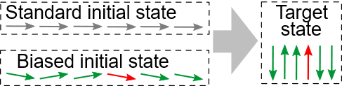







Quantum Annealing With Bias Fields
Quantum 2021 – Bilbao – November 24th 2021
Tobias Grass

Slide 2
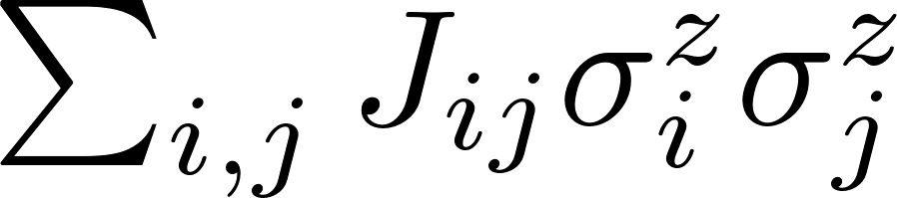
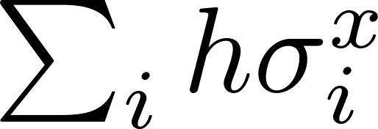
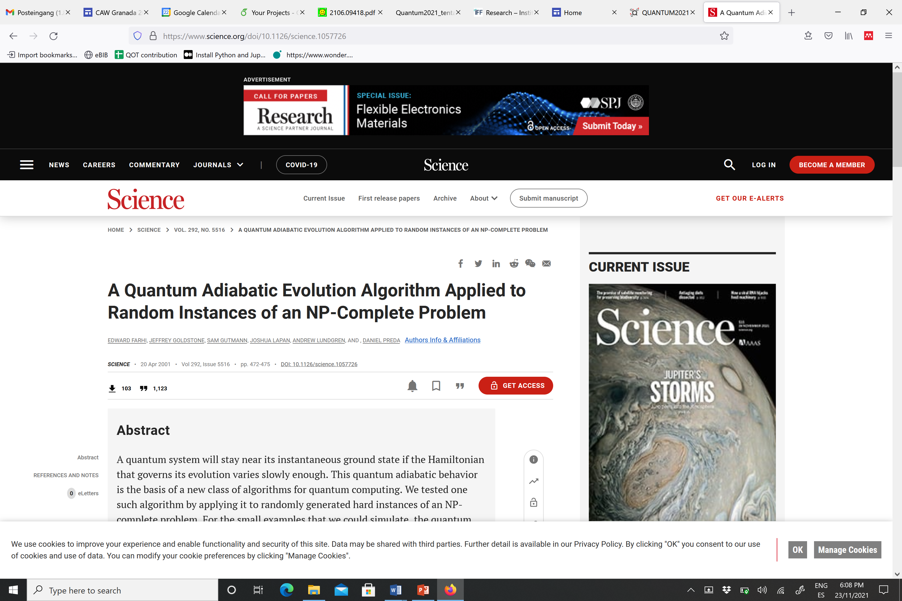
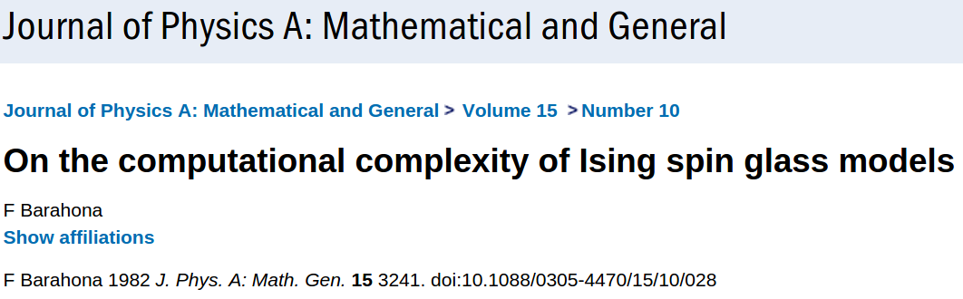
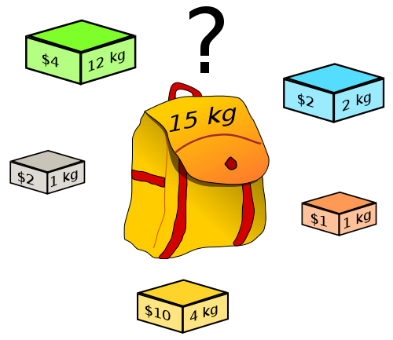



Quantum Annealing – Basic concept
NP-complete
Travelling salesman
Knapsack
partitioning
3 SAT
Exact cover
…
Ising model
transverse field

Slide 3
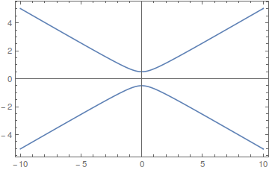
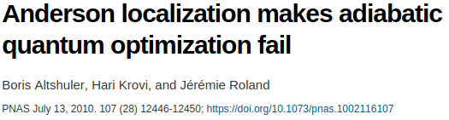
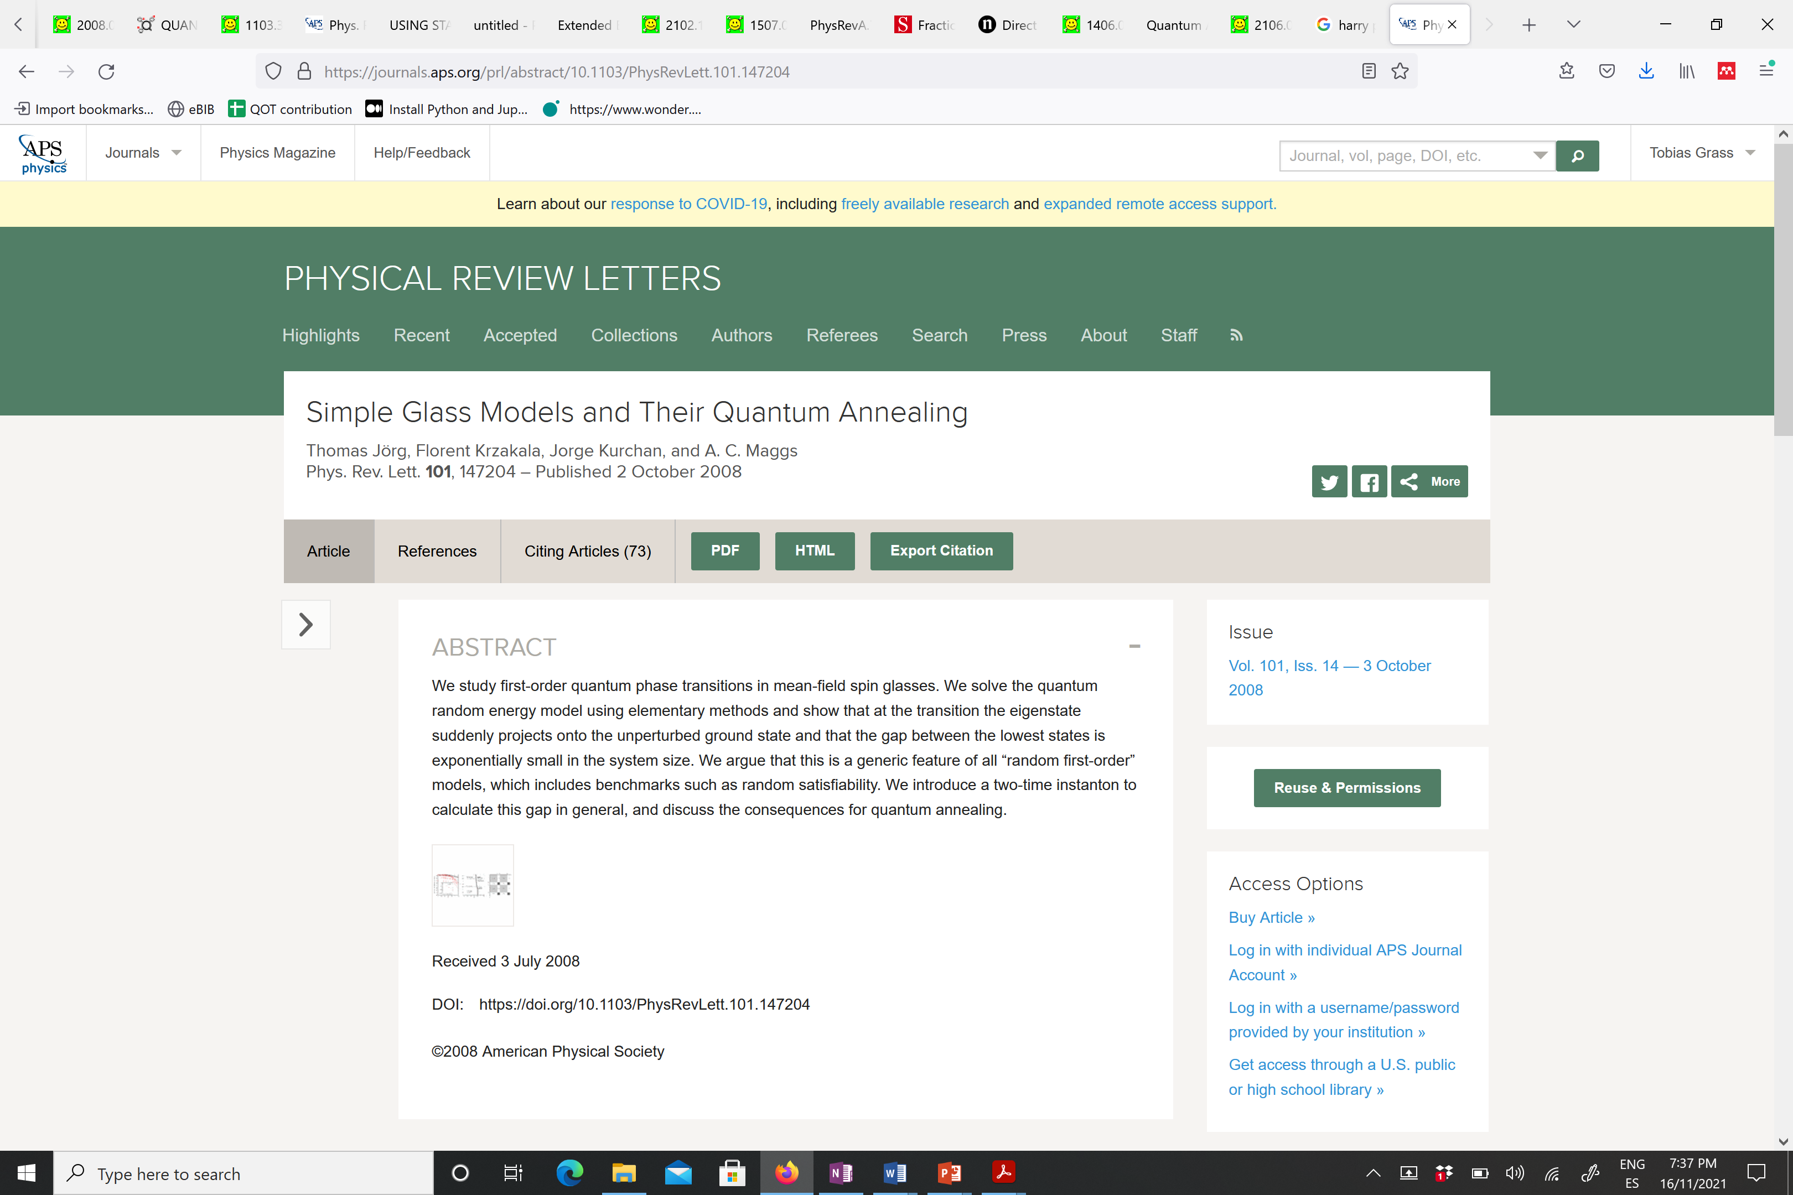
Quantum Annealing – Bottleneck
Landau-Zener problem:
Quantum annealing of NP-hard problems is faced with
exponentially many exponentially small gaps:
Proposed remedies:
Inhomogeneous driver Hamiltonians
Dickson and Amin, Phys. Rev. Lett. 106, 050502 (2011) Farhi, Goldstone, Gosset, Gutmann, Meyer, Shor, Quantum Inf. Comput. 11, 181 (2011) Lanting, King, Evert, Hoskinson, Phys. Rev. A 96, 042322 (2017)
Non-stoquastic driver Hamiltonians
Seki and Nishimori, Phys. Rev. E 85, 051112 (2012) Hormozi, Brown, Carleo, Troyer, Phys. Rev. B 95, 184416 (2017) Albash, Phys. Rev. A 99, 042334 (2019) Ozfidan et al., Phys. Rev. Applied 13, 034037 (2020)
Reverse Annealing
Perdomo-Ortiz, Venegas-Andraca, Aspuru-Guzik, Quantum Inf. Process. 10, 33 (2011) Ohkuwa, Nishimori, Lidar, Phys. Rev. A 98, 022314 (2018)
Modified protocols (adjusted ramps)
Irsigler and Grass, arXiv 2106.08101
Hybrid Approaches
Chancellor, New J. Phys. 19, 023024 (2017). Grass and Lewenstein, Phys. Rev. A 95, 052309 (2017)
Biased Annealing
Grass, Phys. Rev. Lett. 123, 120501 (2019)

Slide 4
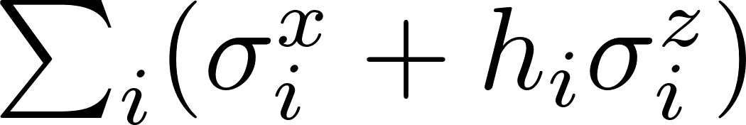
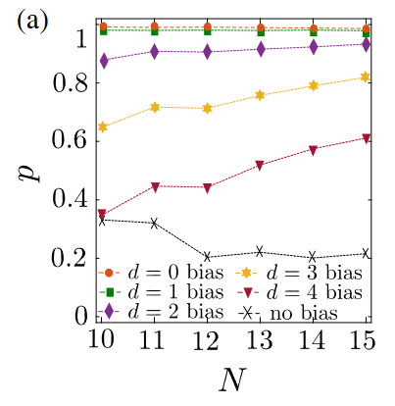
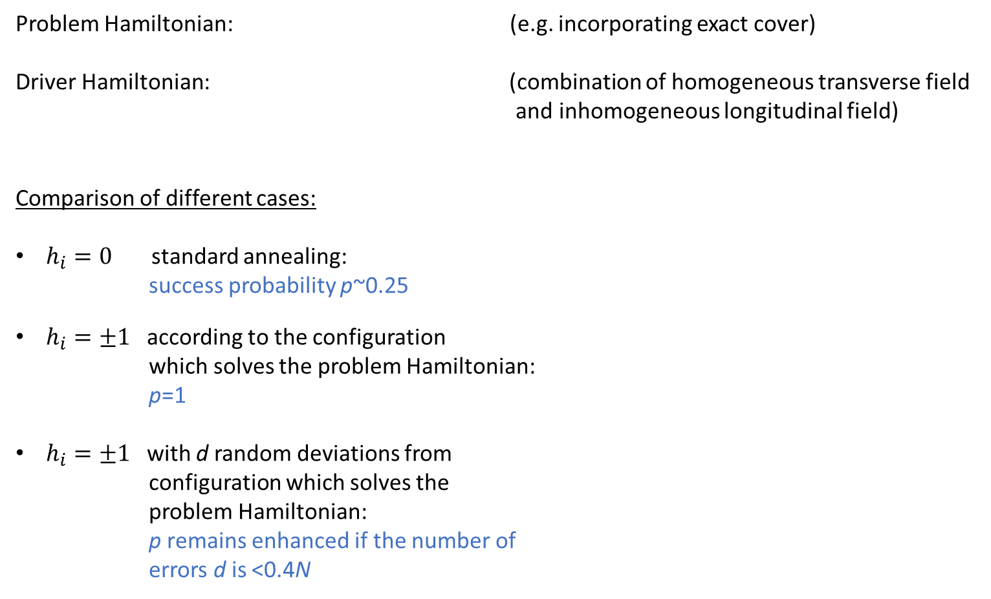
Biased Quantum Annealing
Problem Hamiltonian: (e.g. incorporating exact cover)
Driver Hamiltonian: (combination of homogeneous transverse field
and inhomogeneous longitudinal field)
Comparison of different cases:
$h_{i}=0$ standard annealing:
success probability p~0.25
$h_{i}=±1$according to the configuration
which solves the problem Hamiltonian:
p=1
$h_{i}=±1$with d random deviations from
configuration which solves the
problem Hamiltonian:
p remains enhanced if the number of
errors d is <0.4N

Slide 5
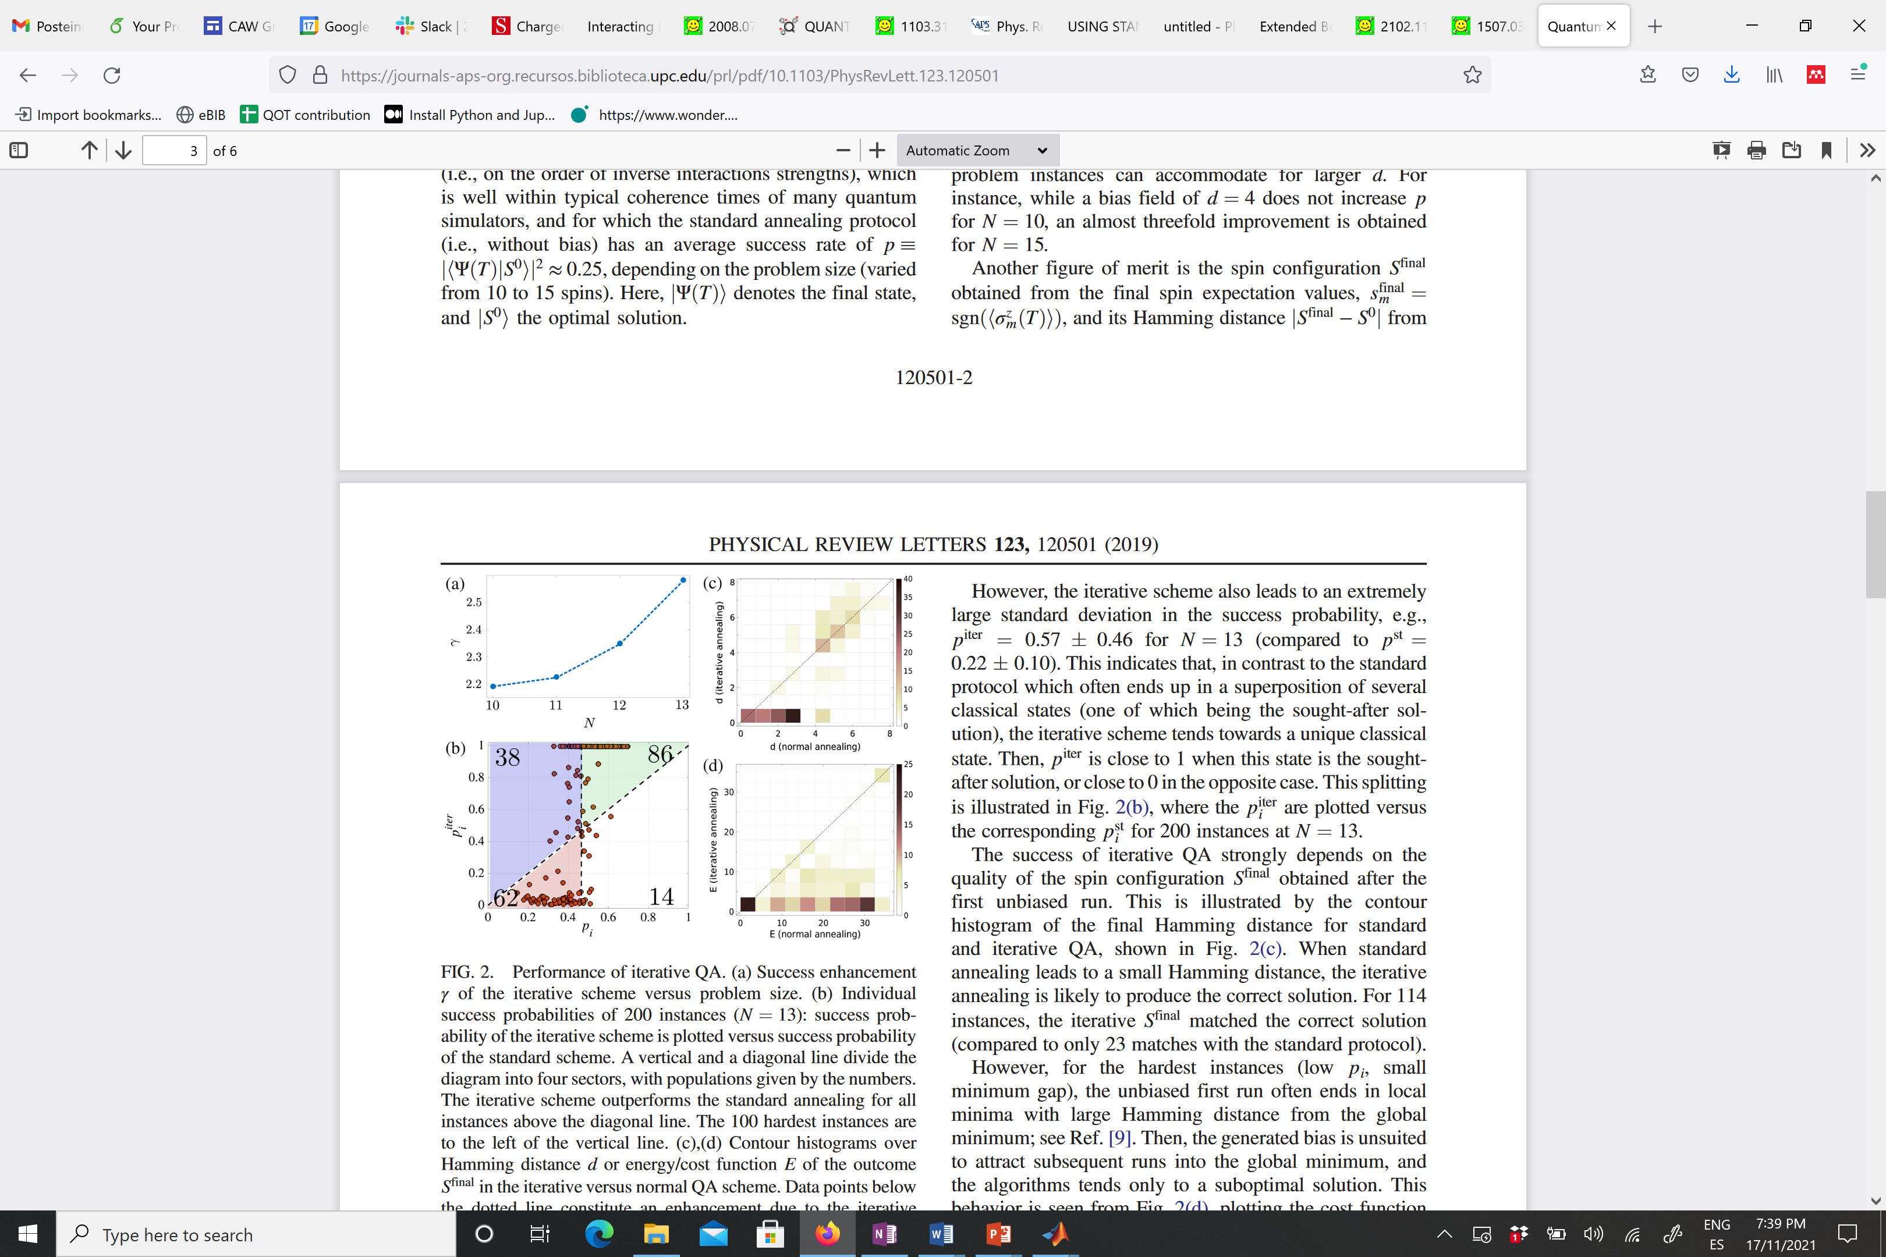
Finding a good bias
Comparison cost function E:
Use some a priori knowledge (e.g. from classical computation)
> Hybrid computing
Iterative approach:
Initialization
Standard quantum annealing
Biased quantum
annealing
Comparison success probability p:
Measure spins in
computational
basis
Iteration
(~3 times)
Define bias
according to
measured spins
Termination
Stop when measurement and bias agree

Slide 6
Finding a good bias
Comparison cost function E:
Iterative algorithm:
Initialization
Standard quantum annealing
Biased quantum
annealing
Measure spins in
computational
basis
Comparison success probability p:
Iteration
(~3 times)
Define bias
according to
measured spins
Termination
Stop when measurement and bias agree

Slide 7
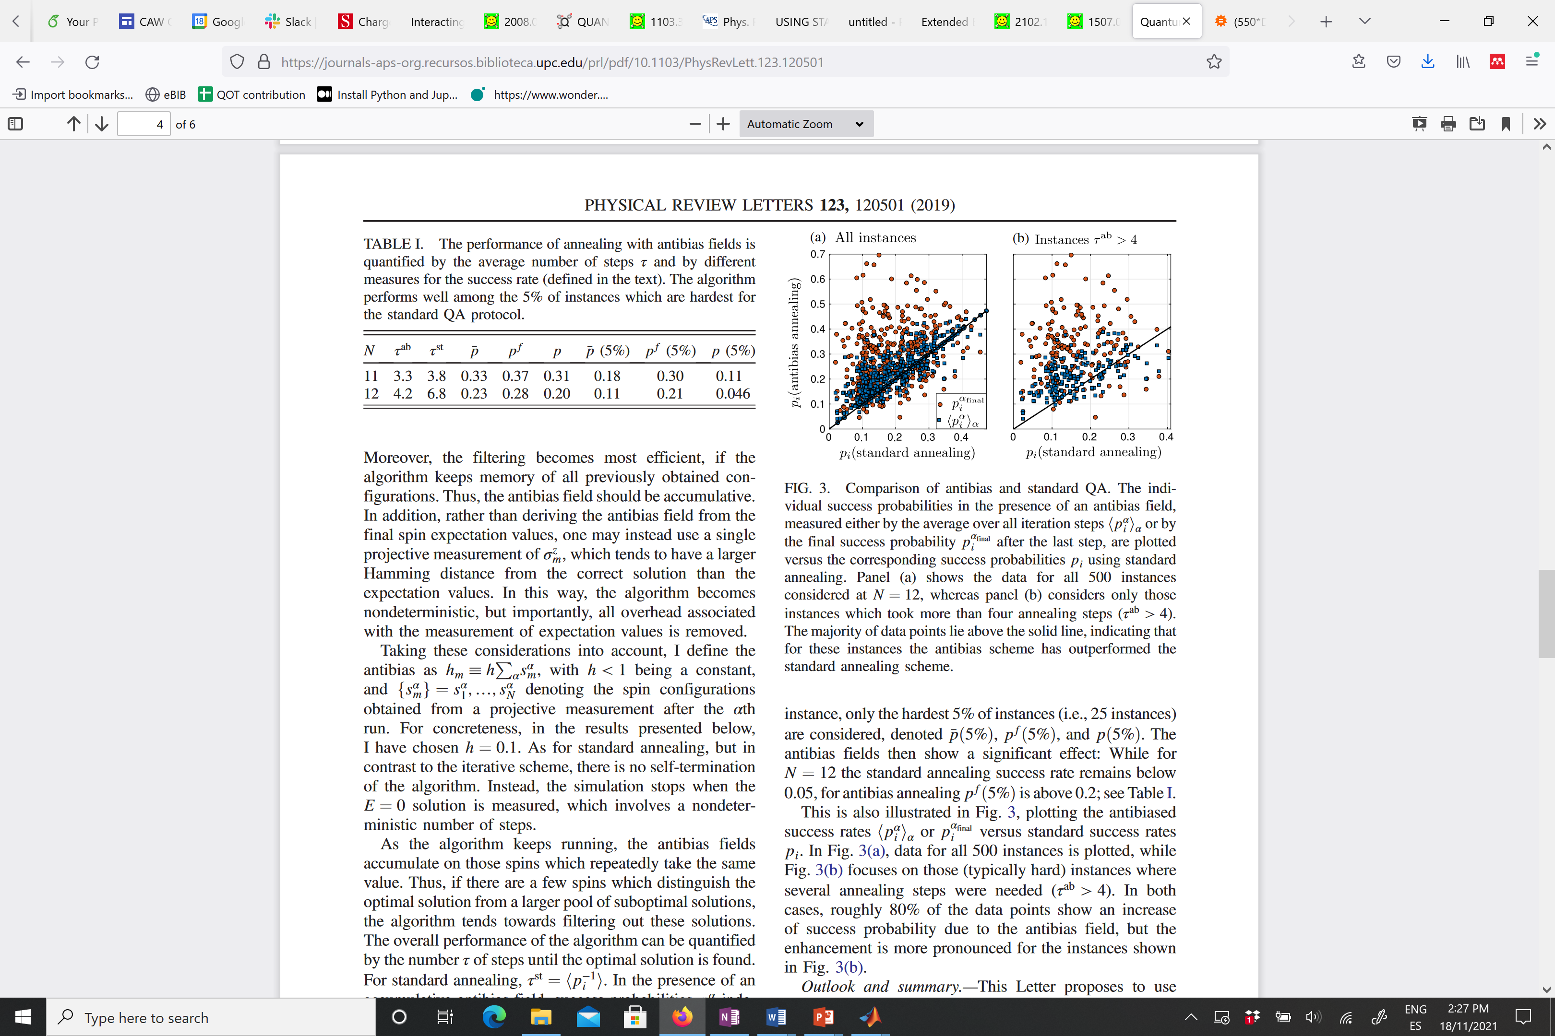
Antibias method
Comparison success probability p:
For hardest instances: iteratively found bias is not good
Alternative approach:
Penalize wrong annealing outcomes with “antibias”
Initialization
Standard quantum annealing
Antibiased quan-tum annealing
Measure spins in
computational
basis
Add configuration to antibias field
Iteration
NO!
# annealing runs until success for standard and
antibias annealing:
Is the obtained configuration the target state?
YES!
Termination
Done.

Slide 8
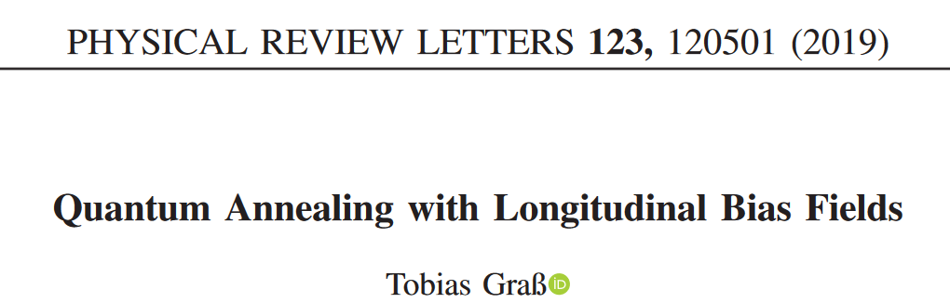
Summary & Outlook
Summary:
Use inhomogeneous longitudinal fields in driver Hamiltonian as bias
Good bias (< 40% errors) increases annealing probability
Can be found iteratively for most instances, but not for hardest ones
Antibias can penalize wrong outcomes to increase success rate
Outlook:
Hybrid approaches
Combination of different “enhanced” annealing methods
Implementation in large-scale (?) annealer
Thank you!
Reference:

